Slide 1

LoRa-Based Wireless Monitoring System For Environmental Irregularity detection
This presentation will explore a wireless monitoring system that uses LoRa to transmit sensor data to an ESP32 microcontroller. It will cover the system's design, implementation, and future plans.
Submitted by : Sayantan Mandal [22BCE8533]

Slide 2
Introduction
Background
LoRa enables long-range, low-power IoT communication for smart agriculture. Wi-Fi and Bluetooth lack range for remote areas.
Machine learning enhances anomaly detection.
LoRa provides better connectivity in harsh environmental conditions.
Problem Statement
Traditional monitoring is short-range, power-hungry, and inefficient.
Manual monitoring is time-consuming.
No automated real-time alert system
.Existing solutions lack predictive analysis for anomaly detection.
Proposed Solution
A LoRa-based system detects temperature, humidity, and soil moisture irregularities.
ESP32 as a receiver, Arduino Uno as a sensor node for real-time alerts.
Real-time data transmission and alerts improve decision-making.
Uses machine learning to analyze trends and predict irregularities.

Slide 3
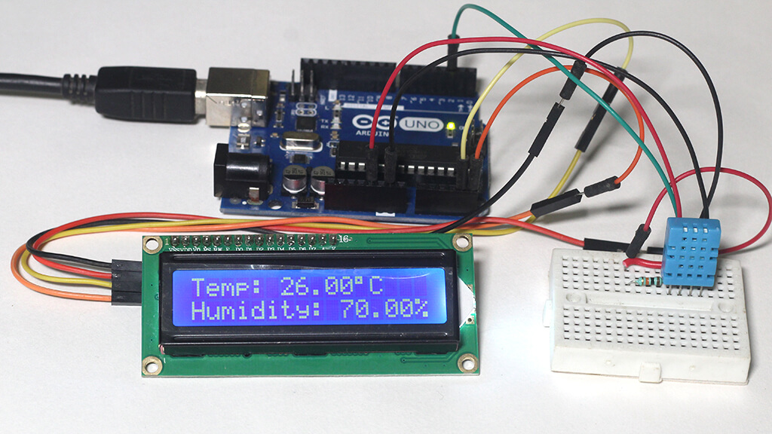
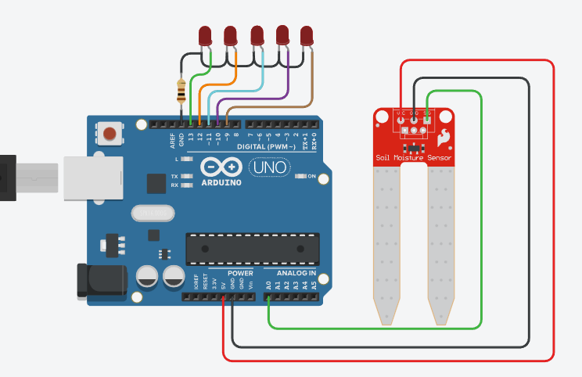
Objectives
Wireless Monitoring
Develop a wireless monitoring system using LoRa communication to transmit data from Arduino to ESP32.
Irregularity Detection
Detect anomalies such as high temperature, humidity, excess water, or bird presence.
Machine Learning-Based Anomaly Detection
Develop a predictive model to analyze sensor data and detect irregularities in
temperature, humidity, and soil moisture.
User Alerting
Notify users of detected anomalies through LED blinking on ESP32 and Arduino, ensuring immediate awareness of environmental irregularities.

Slide 4
Methodology
Hardware Setup
Software & Implementation
Arduino Uno reads data from a DHT11 temperature & humidity sensor and a soil moisture sensor.
LoRa SX1278 is used to wirelessly transmit sensor data to an ESP32.
ESP32 receives data and processes it to detect environmental irregularities.
Alerts are triggered using an LED indicator and can be expanded to a buzzer or LCD display.
Arduino Uno is programmed to collect real-time sensor data and transmit it using LoRa.
ESP32 processes received data and analyzes irregularities using machine learning.
If an anomaly is detected, the ESP32 triggers an LED alert, which blinks 10 times.
The system is designed for low power consumption and long-range communication, making it suitable for remote monitoring.

Slide 5
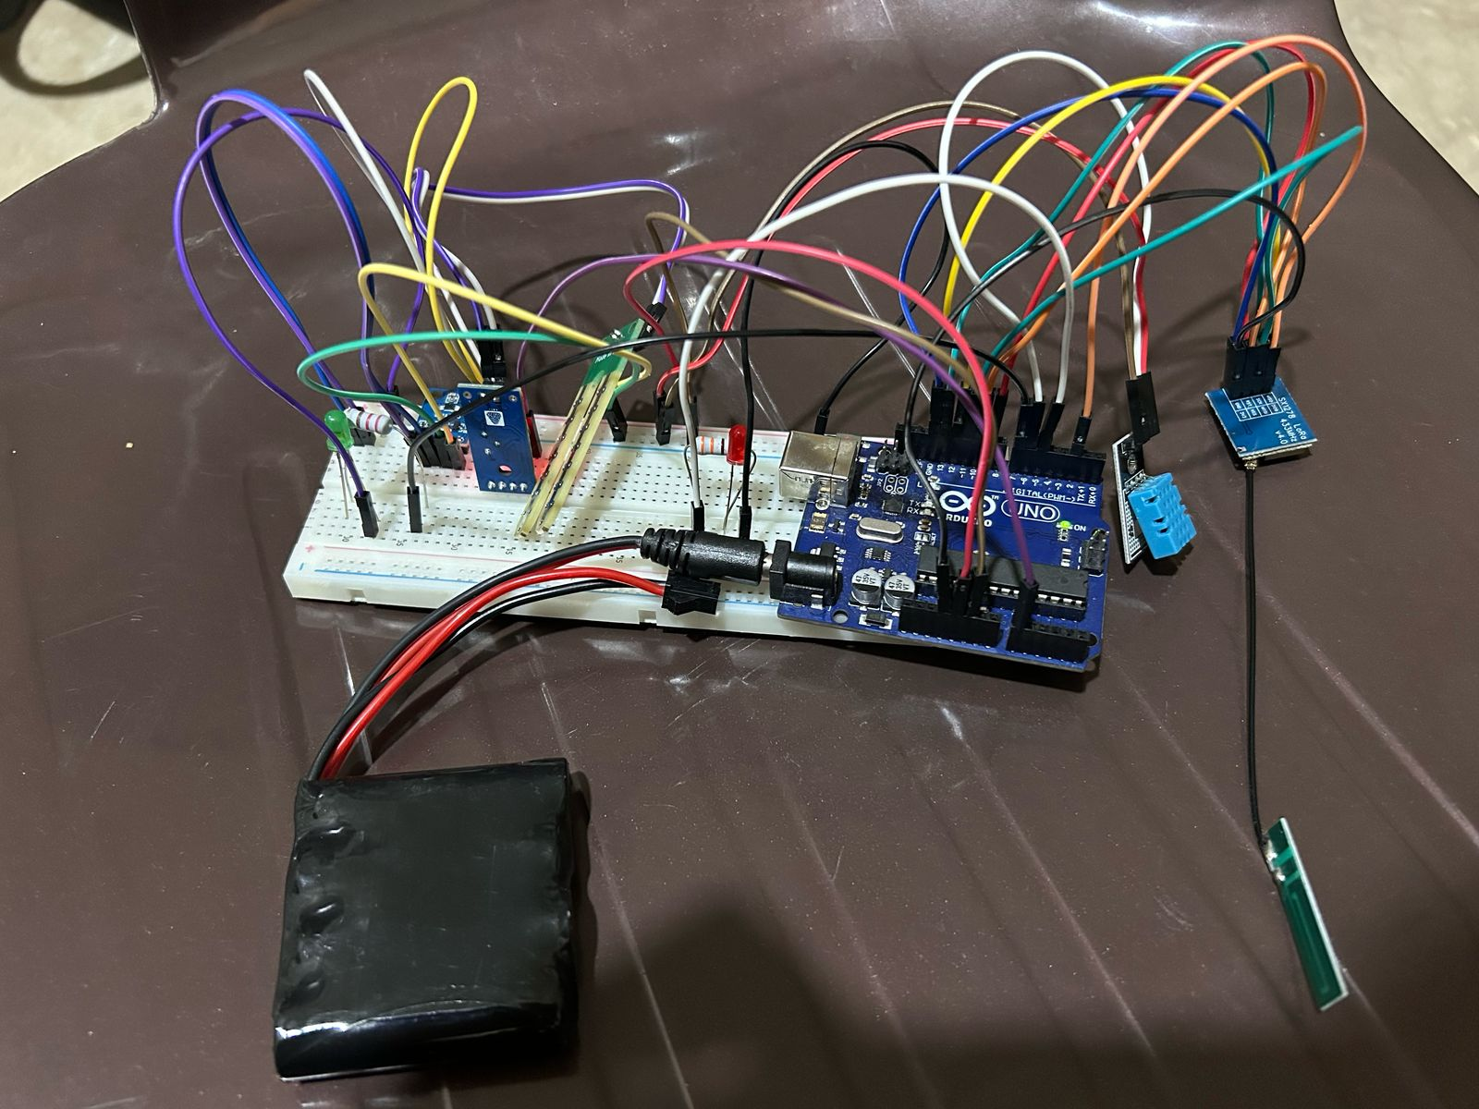


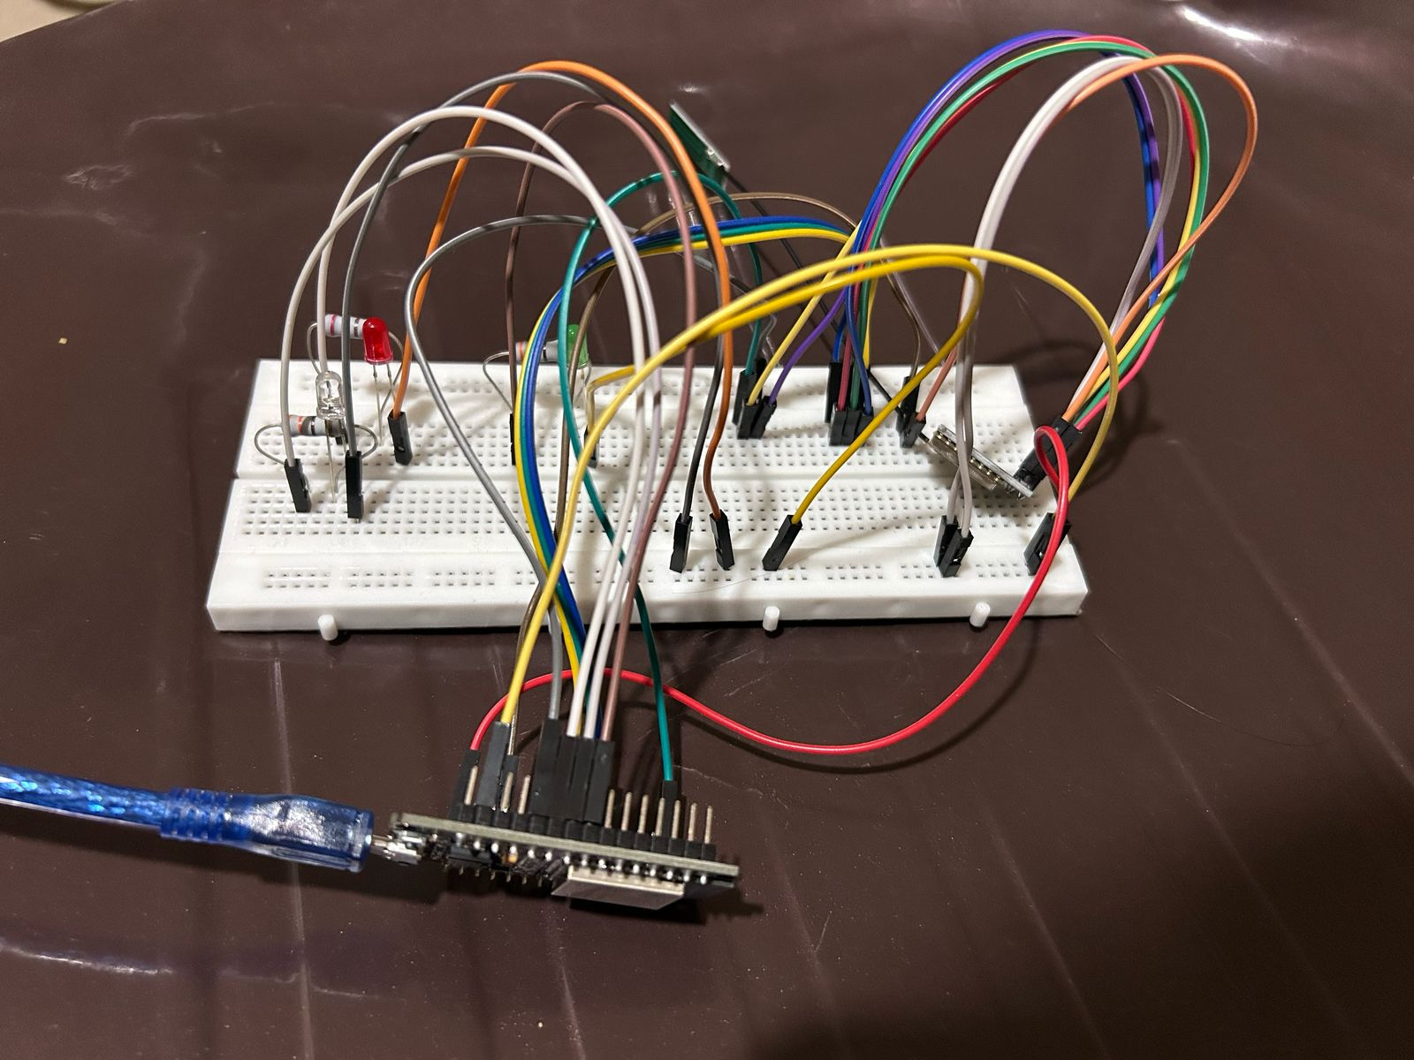
Work Done
Sensor Integration and Calibration
LoRa Communication
Setup and Testing
The DHT11 temperature and humidity sensor and soil moisture sensor were successfully connected to the Arduino Uno. Each sensor was tested individually to ensure accurate readings, and calibration was performed to improve measurement reliability in different environmental conditions.
The LoRa SX1278 module was configured with appropriate settings (433 MHz frequency, SF7, 125 kHz bandwidth) to establish long-range wireless communication between the Arduino Uno (transmitter) and ESP32 (receiver). Several tests were conducted to validate data transmission reliability, measure packet loss, and ensure seamless communication under different environmental conditions.

Slide 6
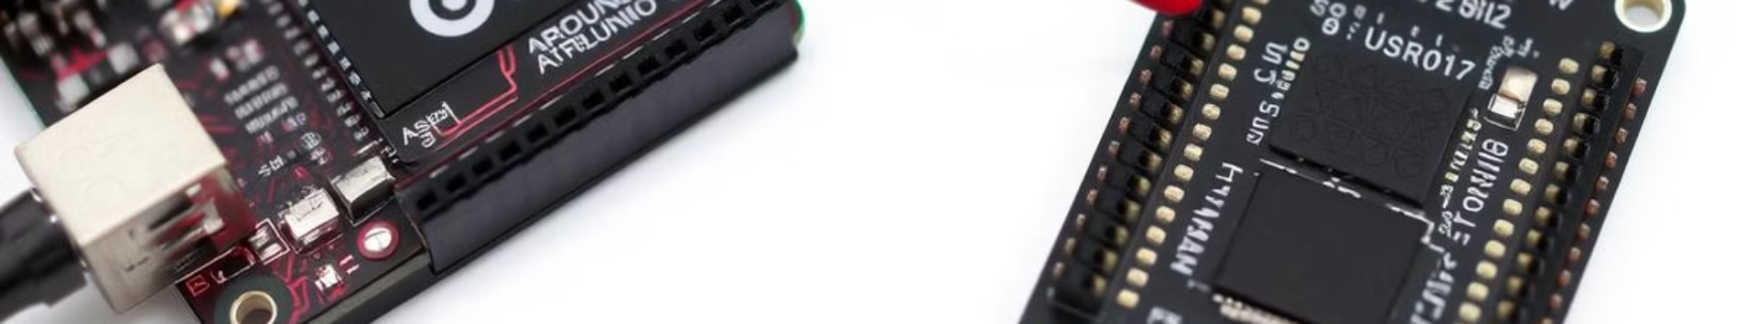
Work to be Done
Power Optimization & Testing
Final Field Testing & Data Validation
Buzzer implementation for audio alerts.
LCD display Integration for visualization of anomaly

Slide 7

References
This presentation has referenced numerous resources.
References
LoRa Technology Overview – Research on LoRa and its applications in IoT.
ESP32 with LoRa using Arduino IDE – A comprehensive guide on interfacing the ESP32 with LoRa transceivers using the Arduino IDE.
Soil Moisture Monitoring in Smart Agriculture – Research on soil moisture sensors and their applications in precision agriculture.
Machine Learning in Environmental Monitoring – Study on applying ML models for anomaly detection.
Energy Efficiency in LoRa-Based Systems – Analysis of power optimization techniques in LoRa IoT devices.

